Slide 1

PRINCIPLES OF LEADERSHIP THE LEADER AS AN INDIVIDUAL
CHAPTER 04
SPRING 2023
FAREED QURESHI

Slide 2
CHAPTER OBJECTIVES
Identify
Identify major personality dimensions and understand how personality influences leadership and relationships within organizations.
Clarify
Clarify your instrumental and end values and recognize how values guide thoughts and behavior.
Define
Define attitudes and explain their relationship to leader behavior.
Recognize
Recognize individual differences in cognitive style and broaden your own thinking style to expand leadership potential.
Practice
Practice aspects of charismatic leadership by pursuing a vision or idea that you care deeply about and want to share with others.
Apply
Apply the concepts that distinguish transformational from transactional leadership.

Slide 3
SIGNIFICANCE
Leadership is both an organizational phenomenon as well as an individual phenomenon.
It is important for leaders to know themselves as well as their followers.

Slide 4
The secret ingredient for leadership effectiveness
Most important capability of leaders: self-awareness.
Self-awareness: Being aware of the internal aspects of one’s nature, such as personality traits, emotions, values, attitudes, and perceptions, and appreciating how your patterns affect other people.

Slide 5
SELF-AWARENESS IS A TOUGH CALL
Blind spots: things leaders are not aware of or don’t recognize as problems—that limit their effectiveness
Self-reflection is important to recognize one’s blind spots.
Perpetual jerks
People pleasers
People skills become far more important on upper layers of management

Slide 6
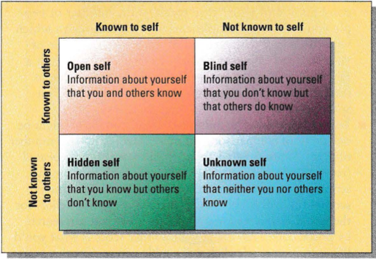
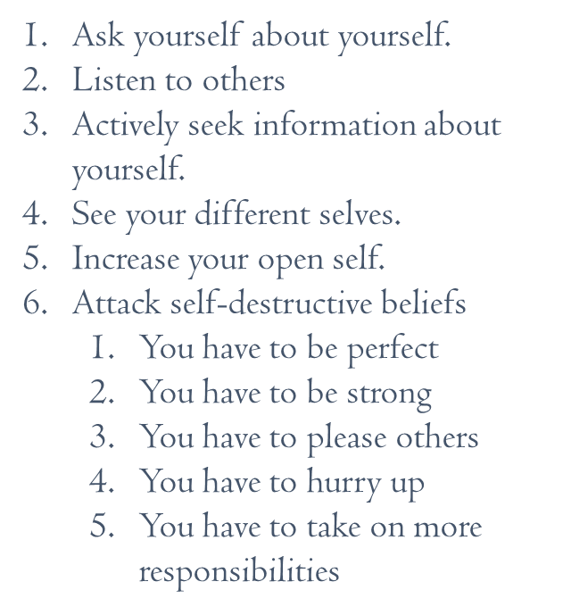
SELF-AWARENESS; THE JOHARI WINDOW

Slide 7

PERSONALITY
The set of unseen characteristics and processes that underlie a relatively stable pattern of behavior in response to ideas, objects, and people in the environment

Slide 8
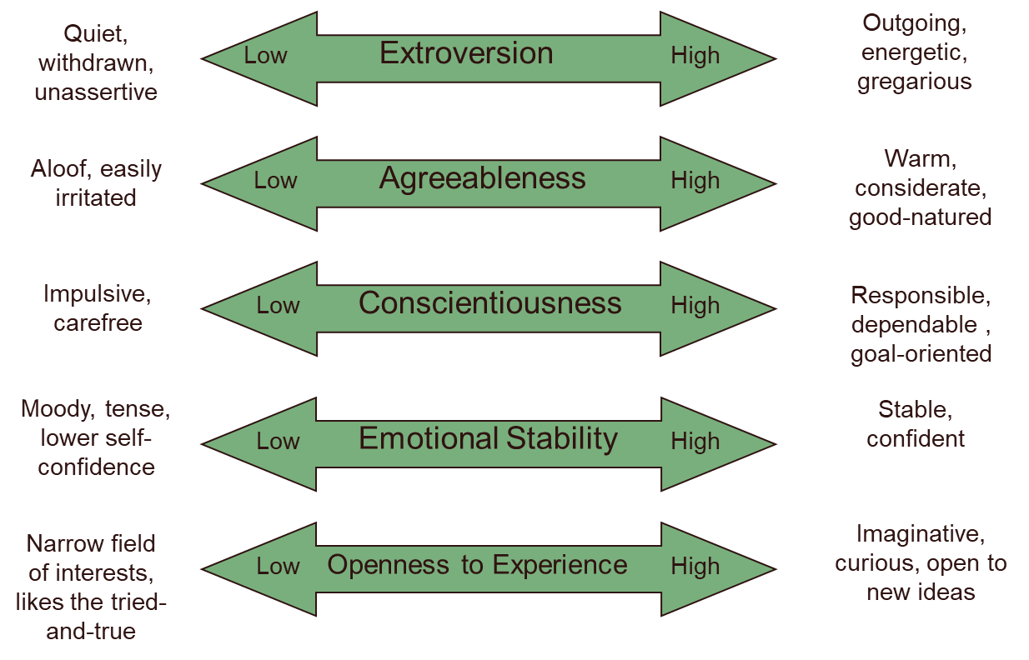
THE BIG FIVE PERSONALITY DIMENSIONS

Slide 9
PERSONALITY TRAITS
Locus of Control
Defines whether a person places the primary responsibility for what happens to him or her within himself/herself or on outside forces
Authoritarianism
The belief that power and status differences should exist in an organization

Slide 10
VALUES
Fundamental beliefs that an individual considers to be important, that are relatively stable over time, and that have an impact on attitudes and behavior.
End Values
Sometimes called terminal values, these are beliefs about the kind of goals or outcomes that are worth trying to pursue.
Instrumental Values
Beliefs about the types of behavior that are appropriate for reaching goals.

Slide 11

ATTITUDE
An evaluation (either positive or negative) about people, events, or things.
Self-Concept
The collection of attitudes we have about ourselves; includes self-esteem and whether a person generally has a positive or negative feeling about him/herself.

Slide 12
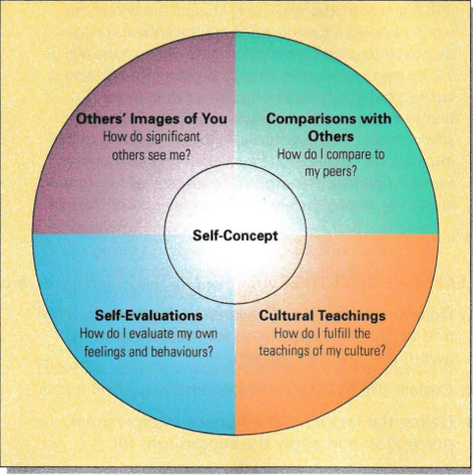
HOW IS THE SELF-CONCEPT FORMED?

Slide 13
DISTINGUISHING CHARACTERISTICS OF CHARISMATIC AND NON-CHARISMATIC LEADERS
 | Non-charismatic Leaders | Charismatic Leaders
Likableness | Shared perspective makes leader likable | Shared perspective and idealized vision make leader likable and an honorable hero worthy of identification and imitation
Trustworthiness | Disinterested advocacy in persuasion attempts | Passionate advocacy by incurring great personal risk and cost
Relation to status quo | Tries to maintain status quo | Creates atmosphere of change
Future goals | Limited goals not too discrepant from status quo | Idealized vision that is highly discrepant from status quo

Slide 14
DISTINGUISHING CHARACTERISTICS OF CHARISMATIC AND NON-CHARISMATIC LEADERS
 | Noncharismatic Leaders | Charismatic Leaders
Articulation | Weak articulation of goals and motivation to lead | Strong and inspirational articulation of vision and motivation to lead
Competence | Uses available means to achieve goals within framework of the existing order | Uses conventional means to transcend the existing order
Behavior | Conventional, conform to norms | Unconventional, counter-normative
Influence | Primarily authority of position and rewards | Transcends position; personal power based on expertise and respect and admiration for the leader

Slide 15
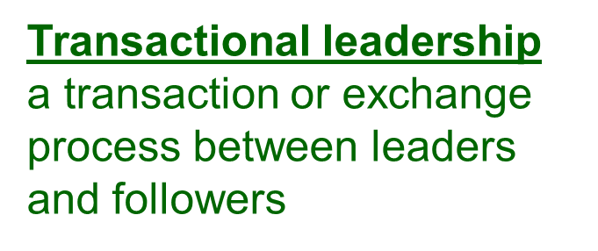
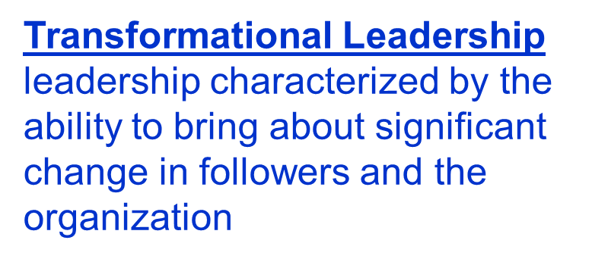
TRANSACTIONAL VS TRANSFORMATIONAL LEADERSHIP

Slide 16
THAT IS ALL FOR TODAY !!

